Slide 2
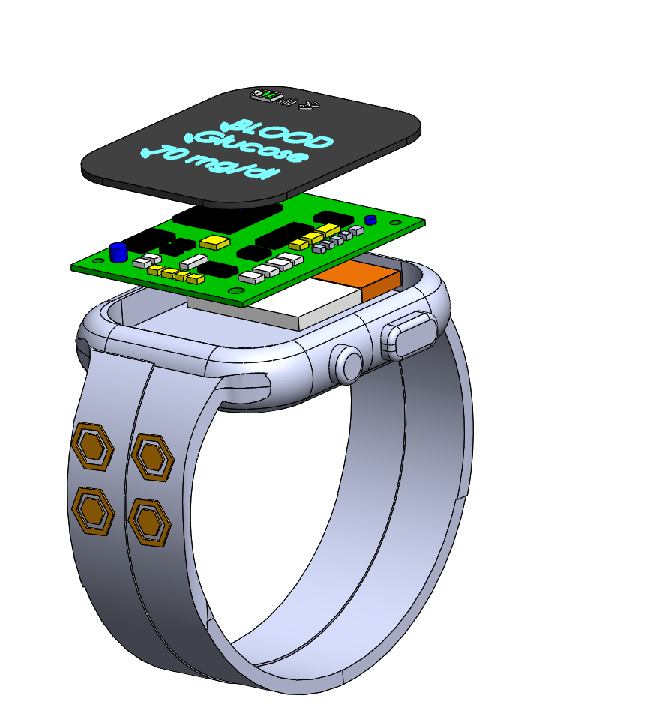

Display
PCB Board
Battery
USB Port
Mic
Switch
Band
Glucose Sensor
Patch

